Slide 1
Capstone Project: Predicting interest levels of new rental listings for RentHop
SIDHANT BHARDWAJ

Slide 2
Executive Summary
The training data provided was in json format and contained 15 features ( text, numerical and categorical) with 49k listings( rows). The target variable is ‘interest_level’ and initially had 3 categories i.e. high, medium, low which were converted into 2 categories i.e. ‘high’ and ‘low’ by merging mediums and highs
Exploratory Data analysis was performed on all the features. For analyzing the text features, word clouds were created to analyze words with more frequencies
Feature Engineering and One Hot Encoding was done to create new features from existing features to better predict the interest_levels.
Models implemented are Logistic Regression, XGBoost and SVM
F1 score was used a metrics for accuracy since 2/3 of the training data had listings with low interest levels and using normal accuracy score would give incorrect accuracy
XGBoost gave the best score with precision of 75%, Recall of 77% and F1 score of 75%

Slide 3
Problem to be solved and Motivation Predicting the interest_levels for listings will help RentHop and owners to indentify quality issues and needs of customers
Finding perfect place to rent results in browsing endless listings on the internet
Structuring and making sense of all available real estate data is hard
Using RentHop data, predictions for interest levels of new listings can be done based on the different features of the listings
Predictions will help people in narrowing down the search for apartments according to the needs
Will help RentHop identify potential listing quality issues
Will allow owners and agents to better understand renters needs and preferences

Slide 4
Features in the dataset Features in the training data set
Bathrooms: No. of bathrooms
Bedrooms: No. of bedrooms
Display_Address: Address of the apartment
Features: List of features about the apartment
Latitude:
Longitude
Manager_id: Manager id for each listing

Slide 5
Features in the dataset Features in the training data set
Price: Price of each apartment in USD
Building_id: building id of apartment
Description: Description about the apartment
Created: Date of the creation of listing
Interest_level: Target variable

Slide 6
Feature Engineering Perfromed One Hot Encoding and created dummy variables from existing features
Created dummy variables ( Dogs_allowed, Cats_allowed,…) from Features variable with occurrence of 1000 times
Created created_year, created_month ,created_day and created_hour from Created Feature
One Hot Encoded manager_id and display_address features
Created num_features, num_photos and description_words

Slide 7
Key Features Price, bedroom, bathrooms, features,num_photos, manager_id, display_address are some of the important features in the data
Some of the features such as Price, bedrooms and bathrooms play vital role in describing the interest level as they are highly correlated and have a p-value less than 0.05
The display address , num_photos, num_features and the dummy variables increased the precision and f1 score of all the three models
Although the p-value of description was less than 0.05 and it did increase the precision in the Logistic regression, it failed to increase the score in the XGBoost model and thus was removed
created_year, created_month and created_hour were not included in the models since they did not increase nor decreased the score of the three models and also had p-value greater than 0.05. Thus to reduce dimensionality, they we removed

Slide 8
Features included in model building Two new features have been added: num_photos and num_featues
With the help of Decision tree classifier, we were able to find the importance of each feature and select the important features accordingly. The features selected are as follows:
Bathrooms
Bedroom
Price
Display_address
Num_photos: Number of photos for each listing
Num_features: Number of features for each listing
Manager_id

Slide 9
Features included in model building A new feature created_day and dummy variables are added to the model
Description
Latitude
Longitude
Created_day: Day the listing was created
Created_month
Feature Dummy variables

Slide 10
Exploratory Data Analysis Interest_level increases as price decreases and vice_versa
The train data consists of 15 features ( numerical, text and categorical) and approx. 50k listings
The target variable is interest level which has 3 classes i.e. high, medium and low which is converted into two classes: high and low
Interest level for 1 bedroom is lowest and is highest for 2 bedrooms
Distribution of price found to be between 1k and 13k after removing the outliers
Low interest levels have average high prices and vice versa

Slide 11
Exploratory Data Analysis Interest_level increase as number of photos and number of features increases
Analyzing price, bedrooms and bathrooms shows that high interest level listings have average price of 2400 usd with 2 bedrooms and 1 bathroom
Low interest level listings have average price of 3300 usd with 1 bedroom and 1 bathroom
Addresses with most listings are Wall st, Broadway, E 34th st, …..
Most common features are Elevator, Dogs_allowed, Cats_allowed,….
Majority of the listings have atleast 3 features followed by 4
Majority of the listings have atleast 5 photos followed by 4

Slide 12
Exploratory Data Analysis Listings were created within a span of 3 months and in the early hours of the morning
All the listings have been created during the year 2016 from April to June
Most of the listings with low interest level was created during the month of June
The high and medium interest level listings seems to have been created uniformly through the months
Most of the low level listings were created during 12 and 21 days of the months
Majority of the listings were created during the very early hours of the morning ( 1 am to 6 am)

Slide 13
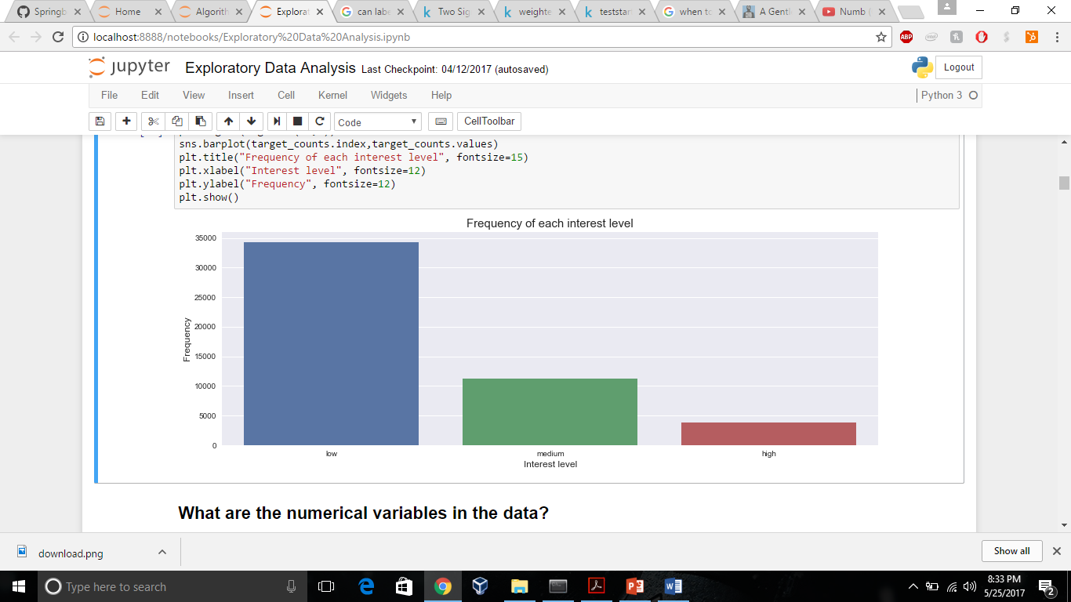
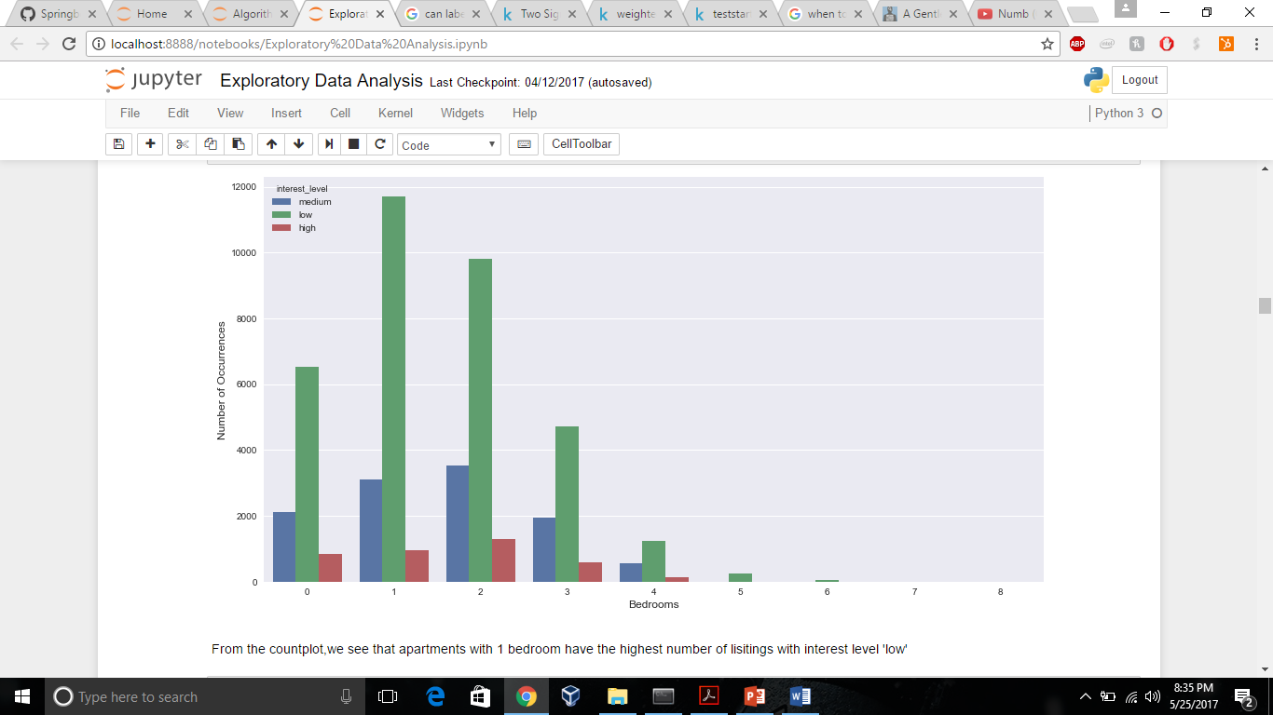
Visualizing the data Majority of the listings have low interest levels. The interest levels are lowest for 1 bedroom and highest for 2 bedrooms

Slide 14
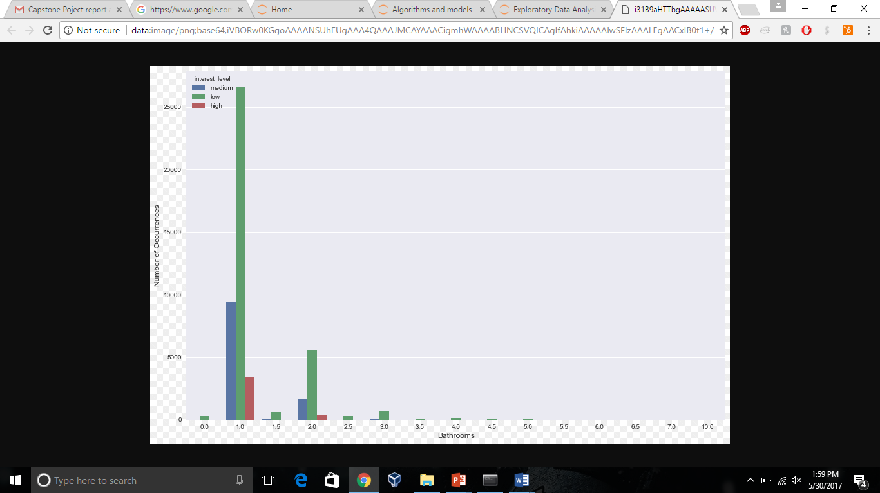
Visualizing the data Interest level is lowest for 1 bathroom, at the same time it is highest as well. Thus there are other factors as well that are causing both interest_levels( high and low) to have 1 bathroom

Slide 15
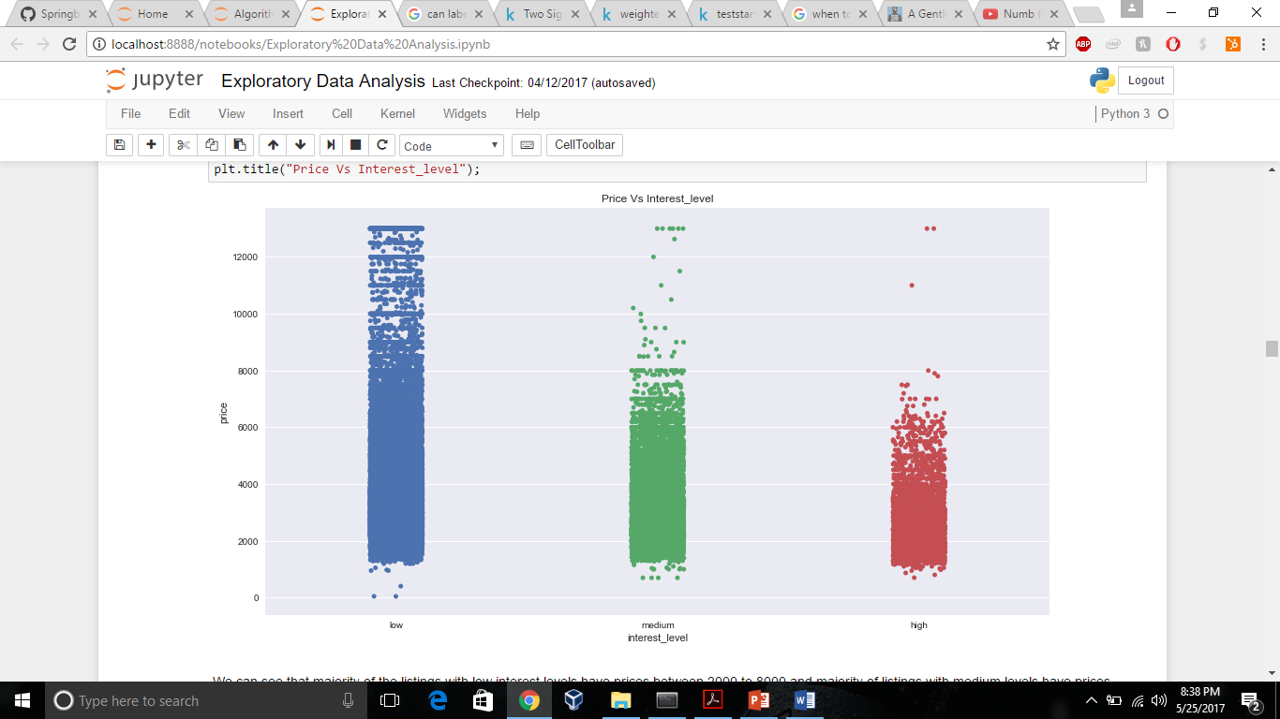
Visualizing the data The interest level increases as price decreases and vice versa

Slide 16
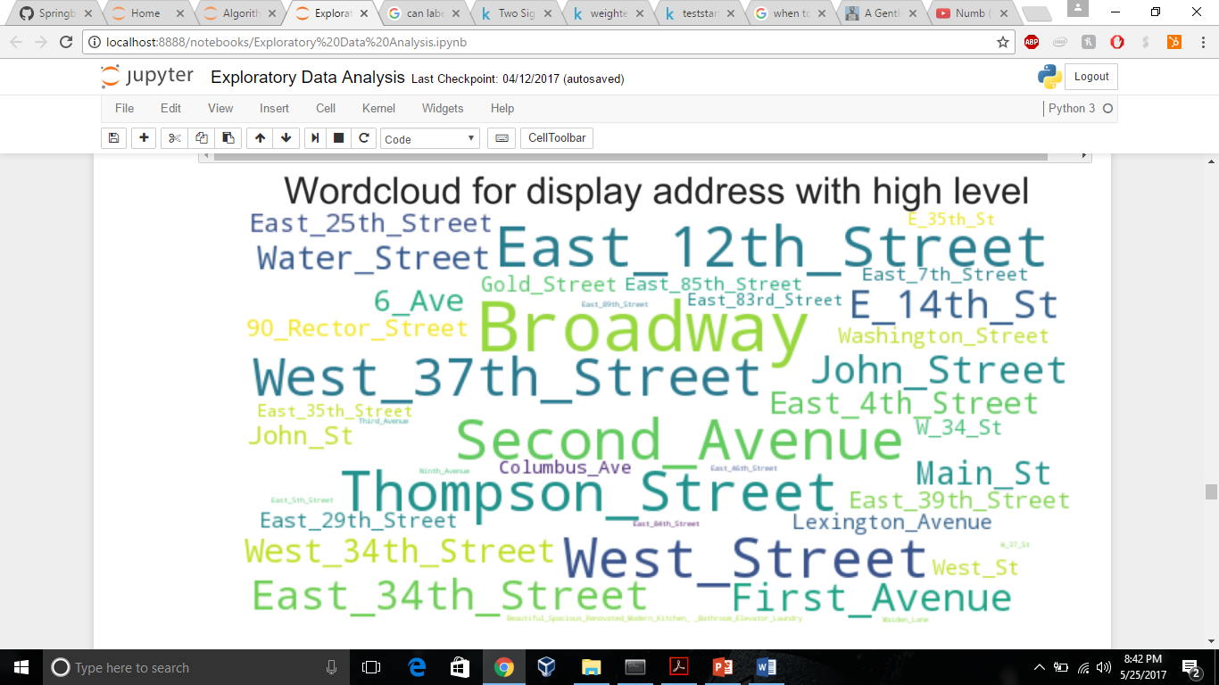
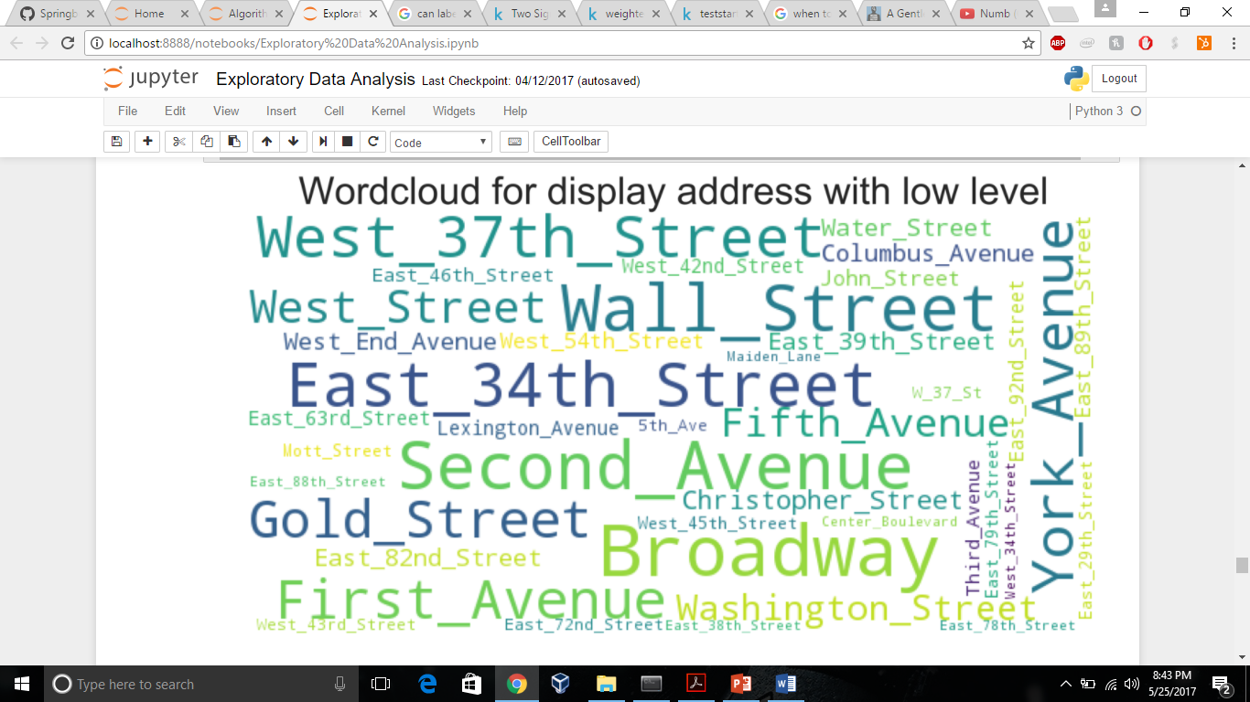
Visualizing the data Display address’s with high interest levels are E 12 st, Broadway etc. Display address with low interest levels are E 34th st, Wall st …

Slide 17
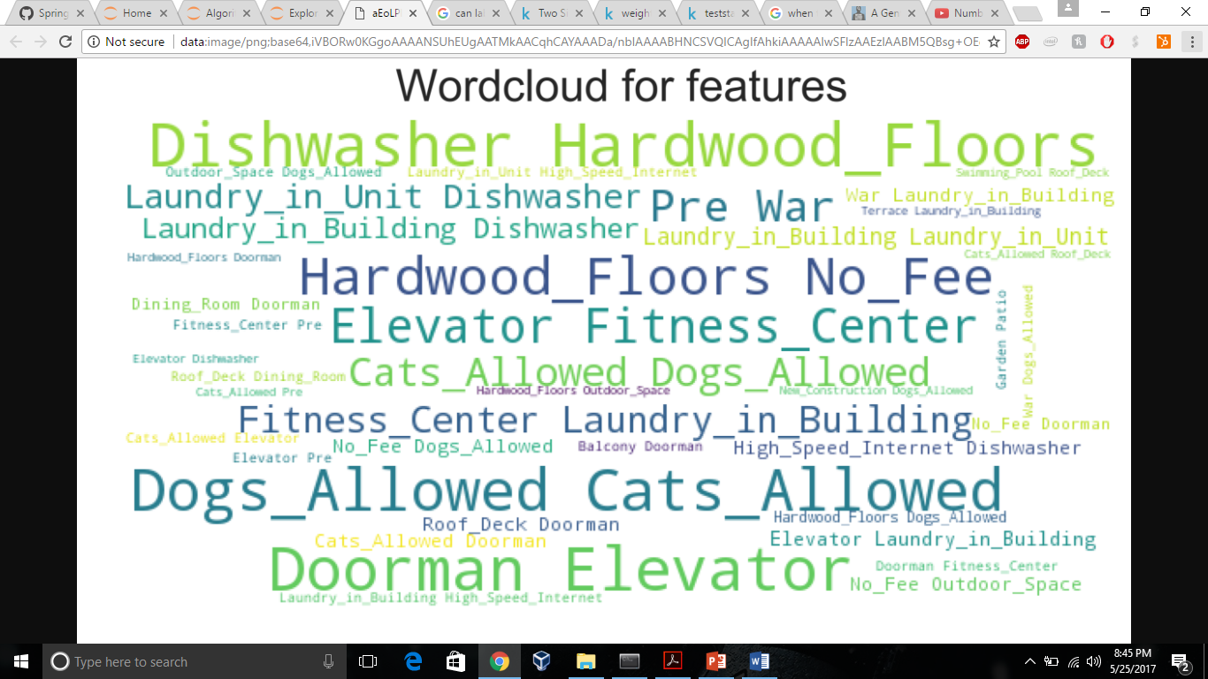
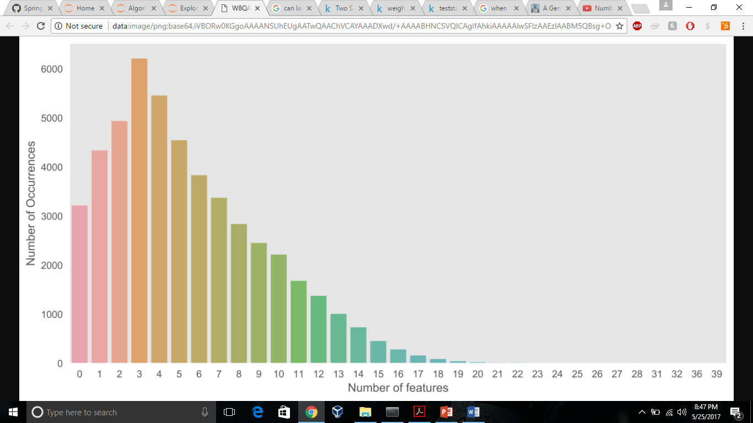
Visualizing the data The most common features are Dogs_allowed, Cats_allowed, Elevator… Most listings have 3 features followed by 4

Slide 18
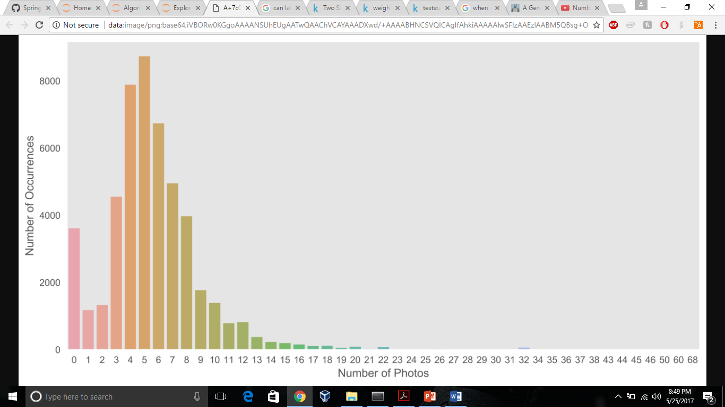
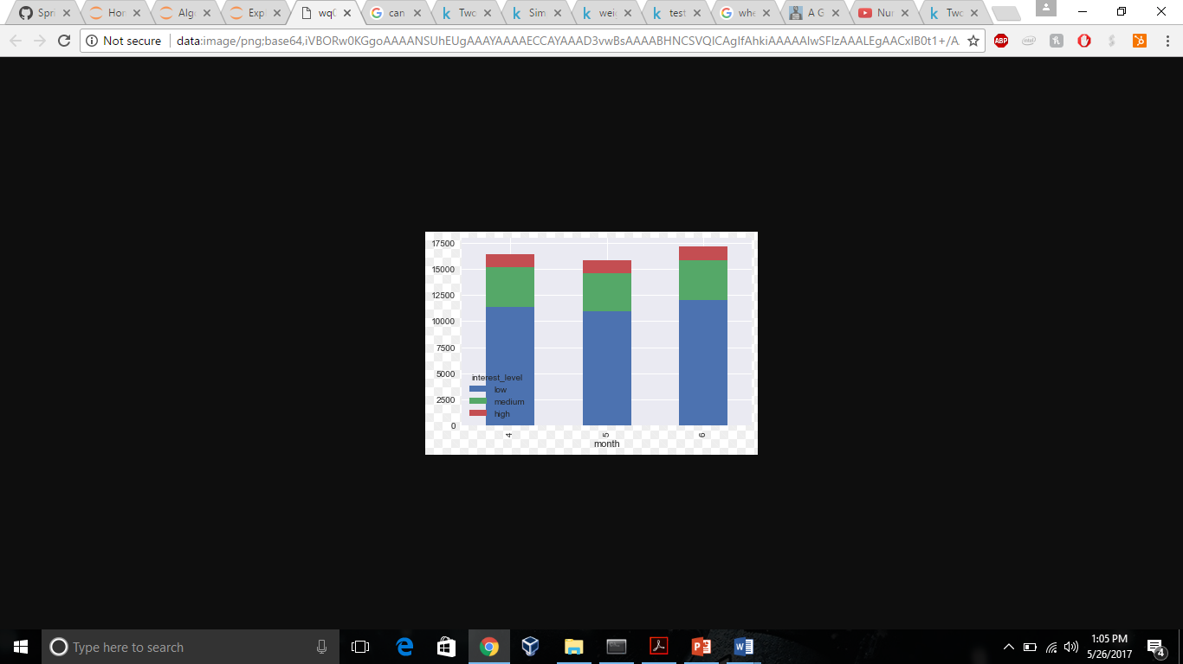
Visualizing the data Most of the listings have 5 photos followed by 4. All the listings( high, medium,low) seems to be created almost uniformly through the 3 months

Slide 19
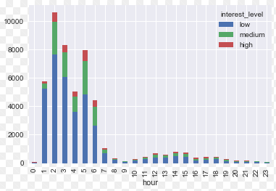
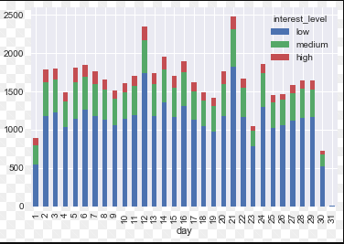
Visualizing the data Majority of the listings seems to have been created during the early hours of the morning. 12 and 21 days of the month seems to be the hot days for creating listings

Slide 20
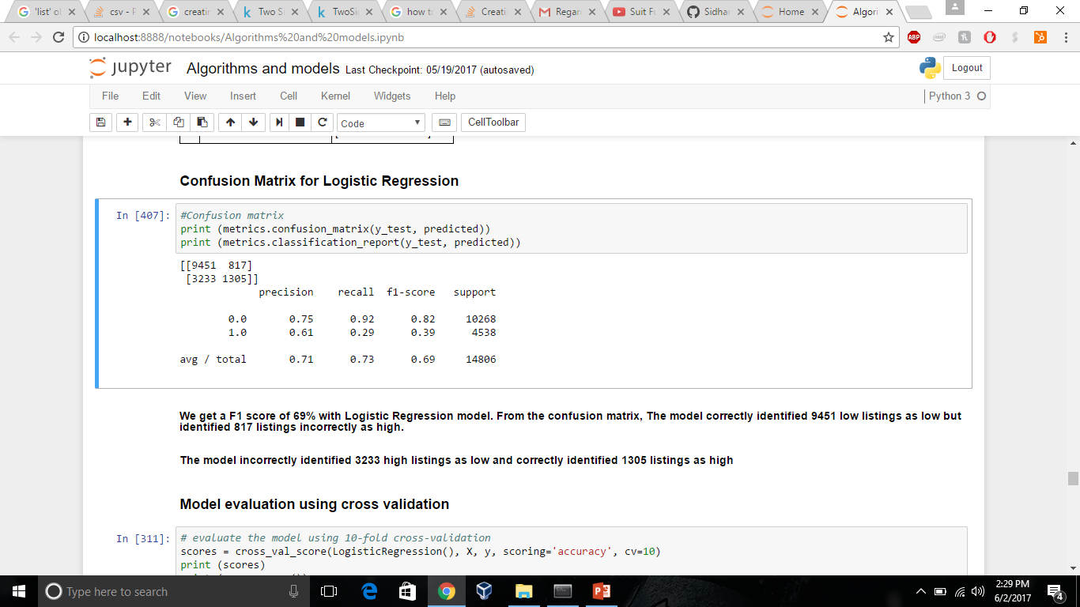
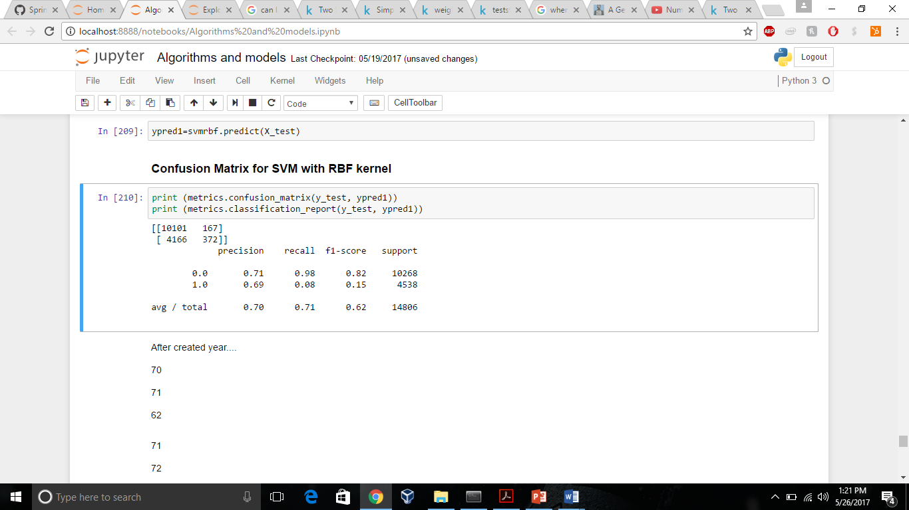
Confusion matrix The Logistic regression model gives better f1 score as compared to SVM model (69% compared to 62%)

Slide 21
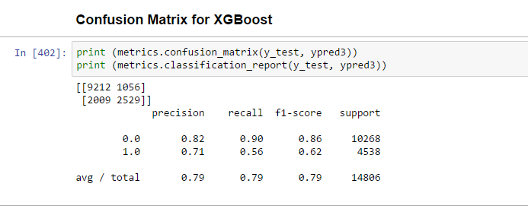
Confusion matrix The XGBoost model gives best result with f1 score of 79% as compared to Logistic Regression and SVM

Slide 22
Algorithms and Results XGBoost gives the best f1 score
Models (Algorithms) | F1 score
Logistic Regression | 0.69
SVM(RBF) | 0.62
XGBoost | 0.79

Slide 23
Why choose XGBoost?
Logistic Regression was implemented as the initial model since the problem at hand was a classification problem i.e. classifying highs and lows
Although Logistic Regression gave f1 score of 68%, implementation of more complex models was done to check if the accuracy score increases
XGBoost model results in increased efficiency and memory resources, and the reason for that is XGBoost builds tree itself in parallel fashion
Thus the information contained in each feature column have statistics calculated on it in parallel along with initial sort of columns
It can be thought of as an alternative to Random Forests, where each tree is trained on the weighted data which emphasizes incorrectly labeled instances by previous trees
As a result we get decreased bias and gives better results

Slide 24
Key TakeAways
The interest level becomes low with high prices and lower number of bedrooms and bathrooms ( 1 bedroom and 1 bathroom)
Interest increases with low pricing with average of 2 bedrooms and 1 bathroom
There are no distinctive addresses where interest levels are high and low. More features such as price, features, bedrooms etc help in differentiating the interest levels
Interest levels increases as the number of features and photos of the listings increases
With features such as cats_allowed, dogs_allowed, doorman, pre war, roof deck, new_construction, the interest_level decreases
Features such as elevator, laundy_in_building, no-fee, balcony increases the interest level
All the listings ( high, low) seems to have been created uniformly through the 3 months
Creation of low level listings seems to spike on the 12 and 21 days of the month

Slide 25
Future Research
Other Models: Other models can be also used for making predictions and potentially improving the score
New features: New features could be created to help us generalize better on the test data and achieving better results

Slide 26


